Slide 1

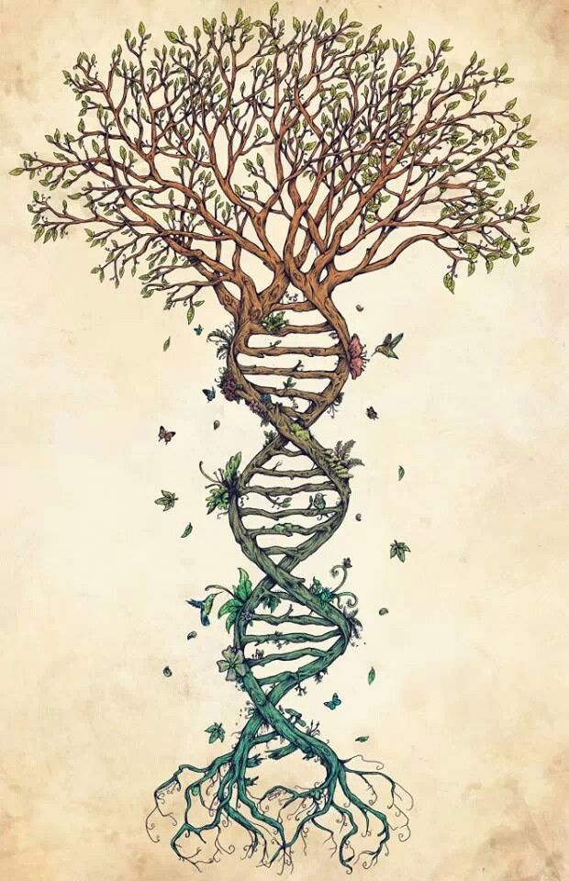
Inferring Phylogenies: BEAST2 and the Protracted Birth-Death model
By Femke Thon & Jolien Gay
Supervisors: Richel Bilderbeek & Rampal Etienne

Slide 2


Research Question
If speciation in nature takes time,
what is the error BEAST2 makes in inferring a phylogeny?

Slide 3
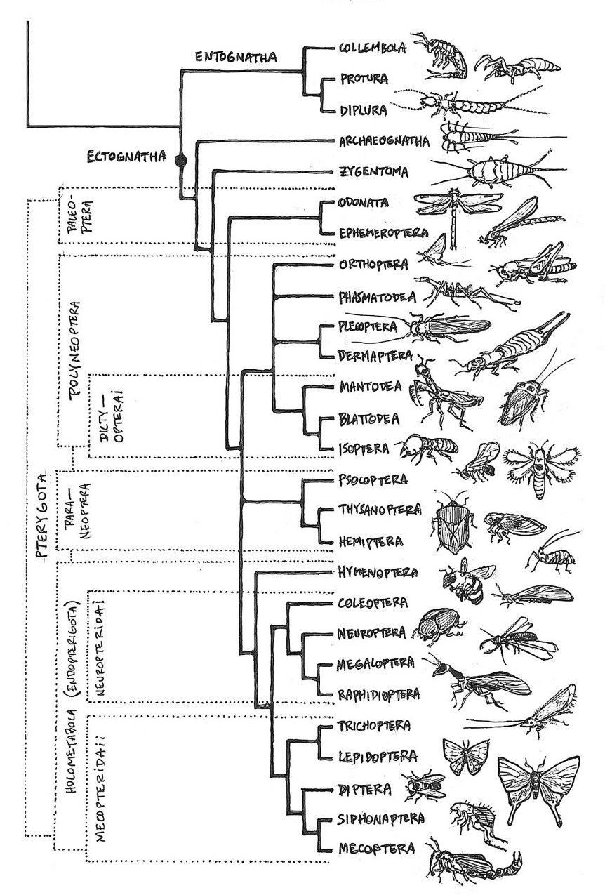
Introduction
Speciation
Evolutionary process
Population -> distinct species (reproductive isolation)
Temporal pattern ??
Phylogenies
Speciation models
Notes:
https://www.reddit.com/r/biology/comments/2t0cgo/a_handdrawn_poster_with_almost_all_insect/

Slide 4
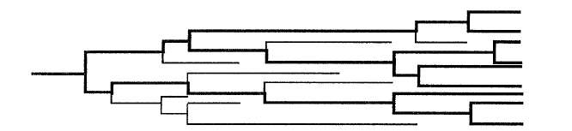
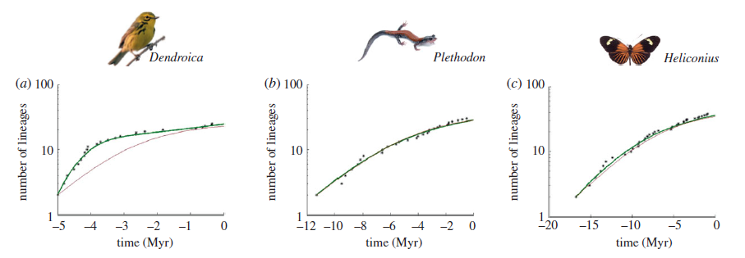
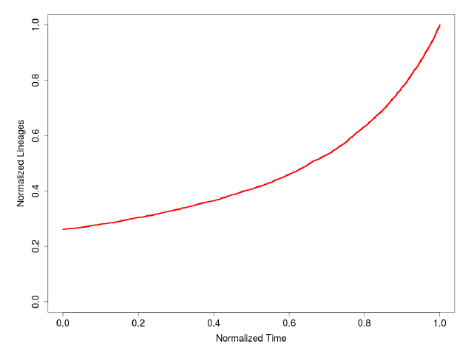
Introduction
Pure Birth-Death model (BD)
Constant speciation and extinction rates
Instant speciation
Number of lineages increase (pull of the present)
BUT: slowdown observed towards the present
Nee Et Al (1994)
vs.
Etienne Et Al (2011)

Slide 5
Introduction
Possible explanations:
Sampling artefact
Diversity dependence
Notes:
Two possible explanations have been proposed to try and explain the observed slowdown
Sampling artifact: 2 artefacts have been found (if a small sample from the actual phylogeny is taken,
BUT: in nearly complete phylogenies, sampling artefact does not explain the observed slowdown
Species-level density dependence: no constants speciation or extinction rates like in the pure BD model. Because of niche filling they will decrease with time.
BUT: new species may create new niches

Slide 6
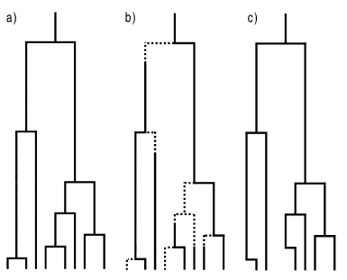
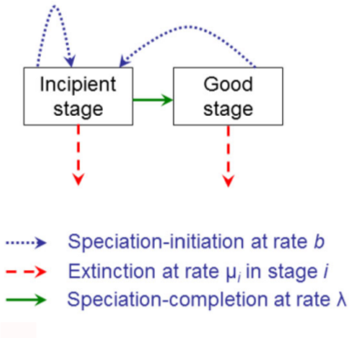
Introduction
Protracted Birth-Death model (PBD)
Extension of BD
Assumes speciation takes time
Assumes two states
PB | PBD | phylogeny
Etienne and Rosindell (2012)

Slide 7
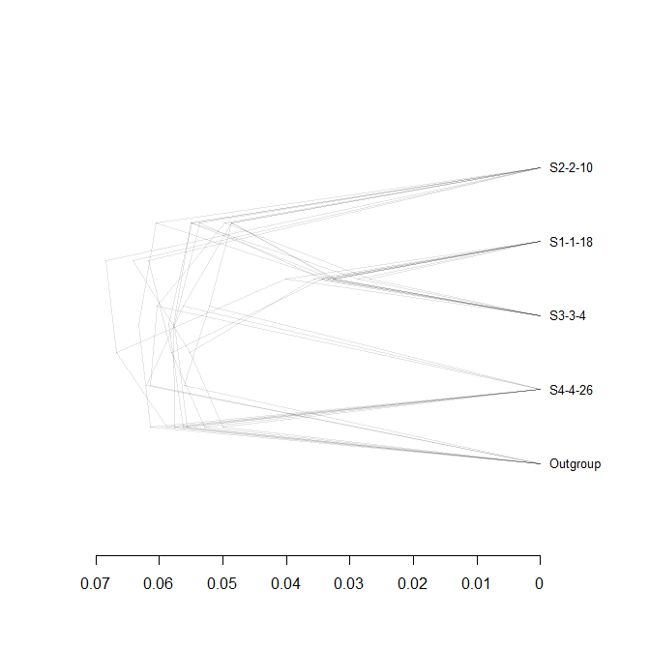
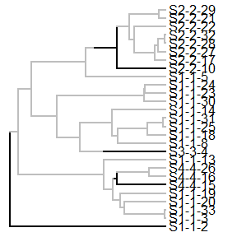

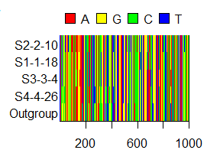
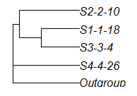
Material & Methods
‘true’ tree
posterior
species tree
alignment

Slide 8
Main Question
If speciation in nature takes time,
what is the error BEAST2 makes in inferring a phylogeny?
Sub questions
Can BEAST2 accurately recover a ‘true’ tree?
Error big enough?

Slide 9
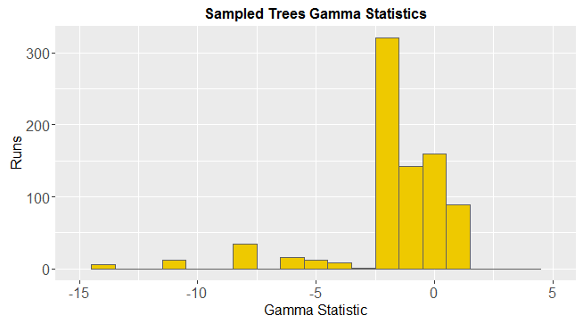
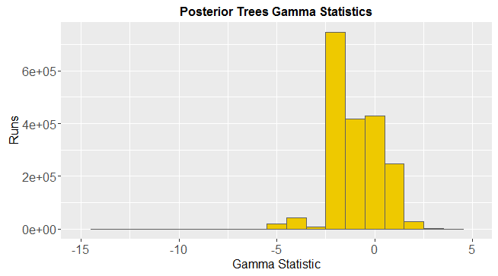
Results: Distribution gamma statistics

Slide 10
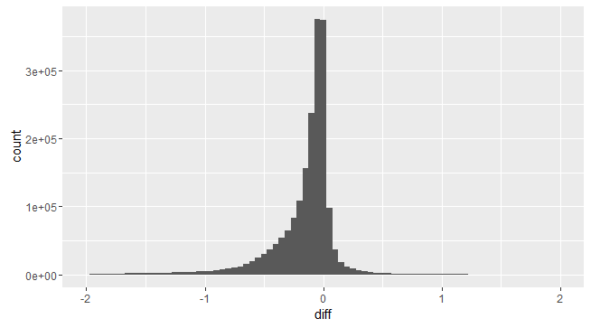
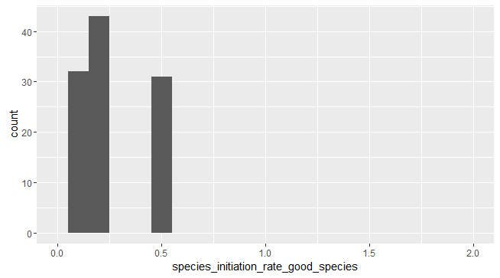
Results: Comparison Gammas
Notes:
Graph 1: The lower the 'comparison' value, the bigger the error of BEAST towards higher gamma statistics.
Interestingly, some parameter values don't show up in the lower comparison values. The higher values for the speciation initiation rate for example (0.8 and 1). This turned to be because of missing posterior gammas for those parameters. All files after ```article_1_5_5_2_2.RDA``` appear to be corrupted.

Slide 11
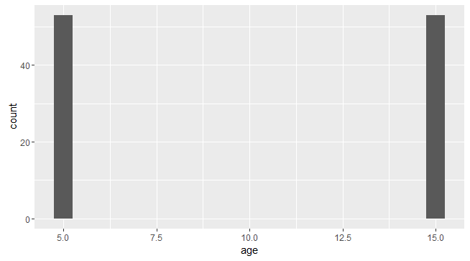
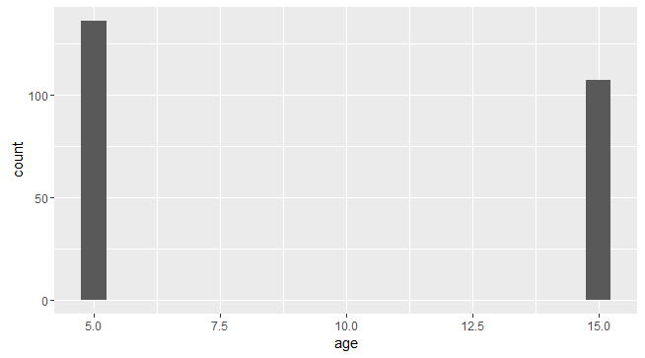
Results: Age
Big difference
Small difference

Slide 12
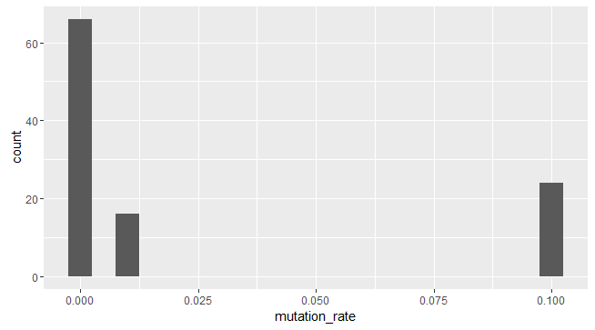
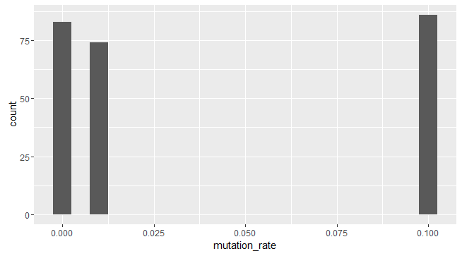
Results: Mutation Rate

Slide 13
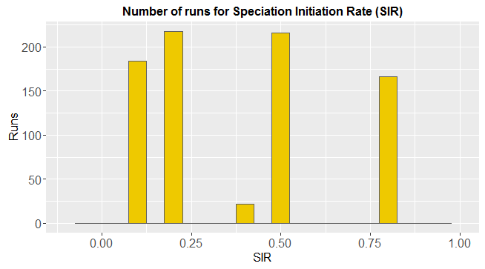
Results: Speciation Initiation Rate (SIR)
Notes:
It seems like there is one parameter which is unusually often present in corrupt files: a species initiation rate of 0.4. For some reason, these are very often corrupted. This is very unexpected, as we’d expect something going wrong with the program if the computer would be overwhelmed by calculations - for example if the speciation initiatoin rate is high. But high speciation rates seem to be fine:

Slide 14
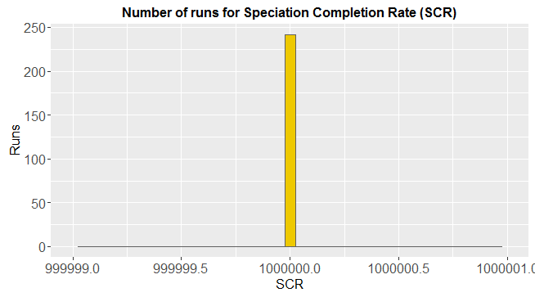
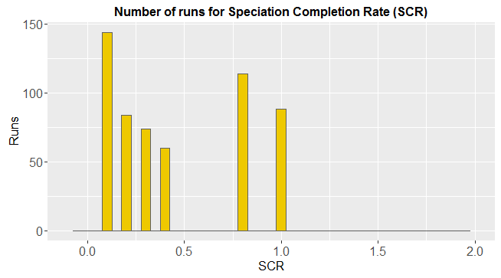
Results: Speciation Completion Rate (SCR)

Slide 15
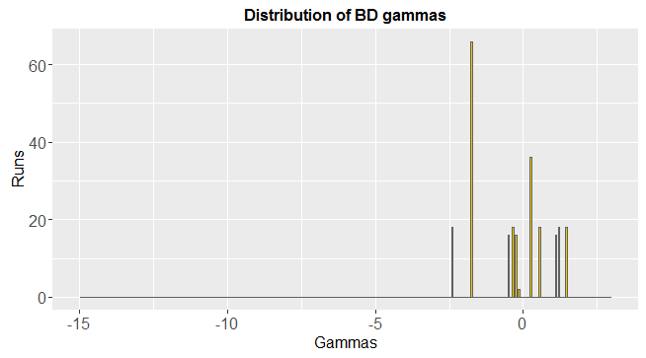
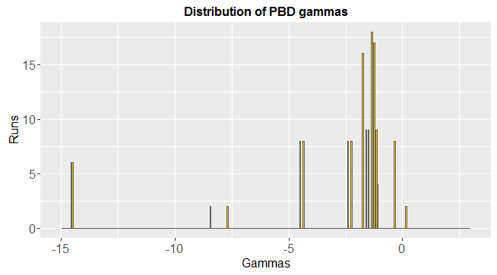
Results: Gamma Distribution

Slide 16
Discussion & Conclusions
Error gamma statistics: substantial

Slide 17

Questions
Notes:
POSSIBLE QUESTIONS?:
Q1: Why did you use an outgroup?
Q2: Are the used summary statistics the best, and why?

Slide 18

BEAST2
Bayesian statistics
MCMC
Multiple speciation models can be applied
All assume instant speciation
Posterior
Prior
Likelihood
Marginal probability

Slide 19
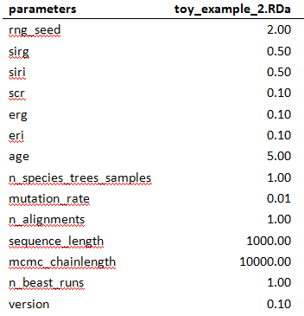
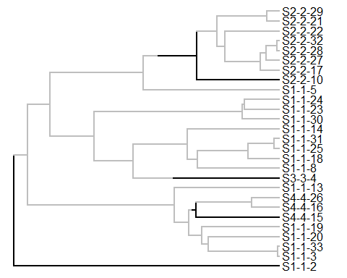
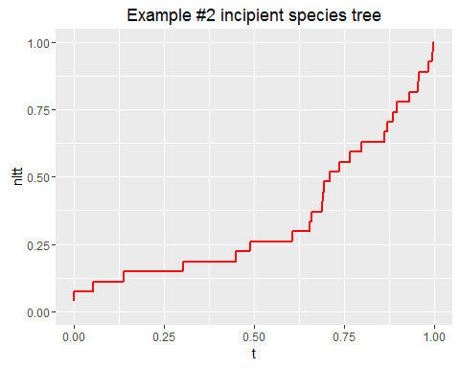
1. Start with ‘true’ species trees
Create parameter files
Simulate incipient tree / parameter file

Slide 20
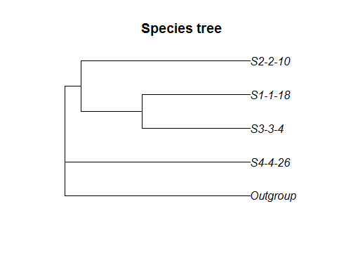
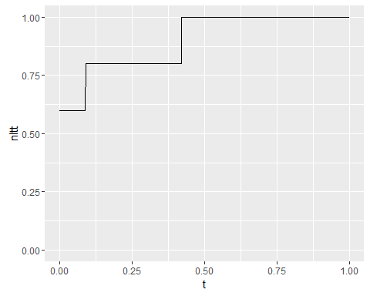
2. Sample a (monophyletic) species trees
Sample unique species from incipient tree (2x)
Add outgroup
Notes:
Outgroup may be unnecessary. Constant clock rate used.

Slide 21
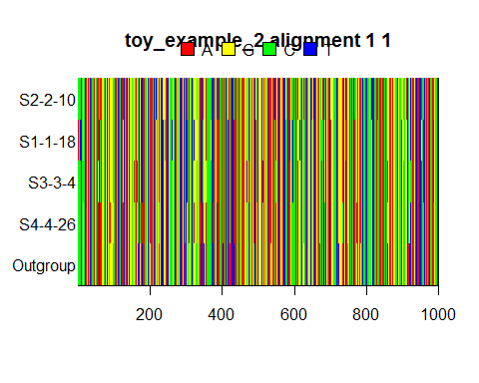
3. Convert to DNA alignment
Input BEAST2
Simulate alignment from species tree (2x)

Slide 22
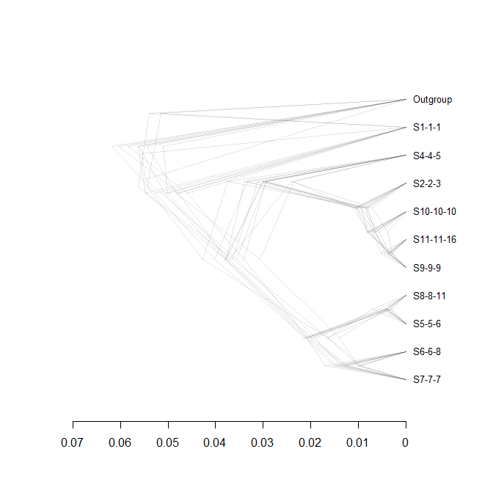
4. Infer a posterior (BEAST2)
Output BEAST2
Posterior / alignment (2x)

Slide 23
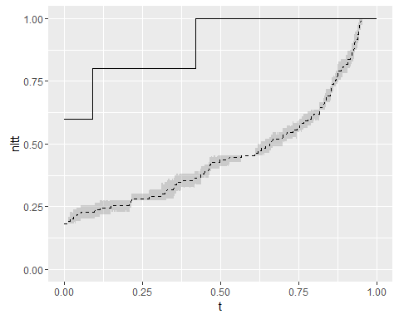
5. Analysis
Compare posterior with sampled true species tree (from step2)
Summary statistics to quanitfy error (gamma, ....)

